Slide 1
Investigating if Copy Number Variations Associated with Early or Late Replication Regions
Johannes Menzel
MOLB 7621
University of Colorado

Slide 2
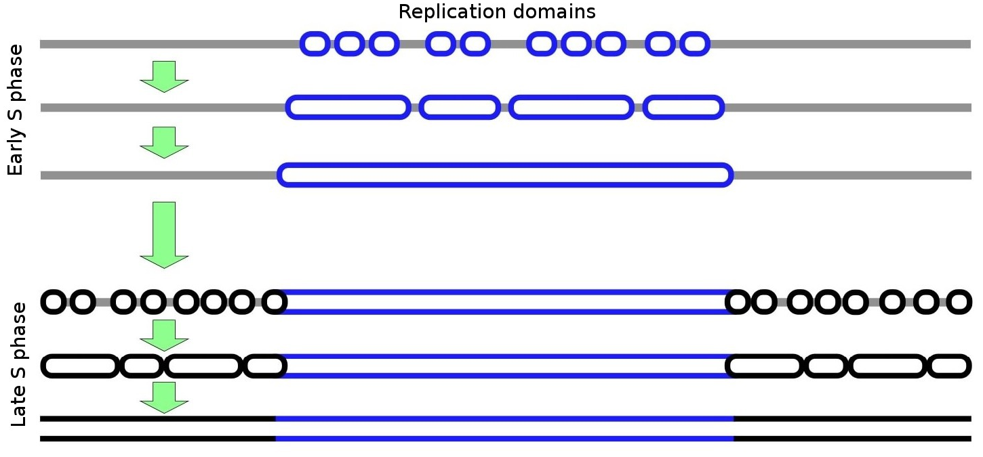
DNA Replication Timing

Slide 3
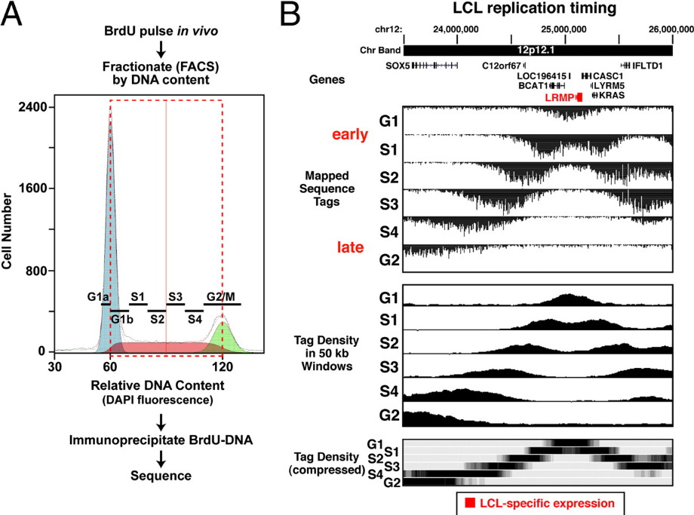
Replication Timing Data "Repli-seq"
Hansen et al 2010

Slide 4
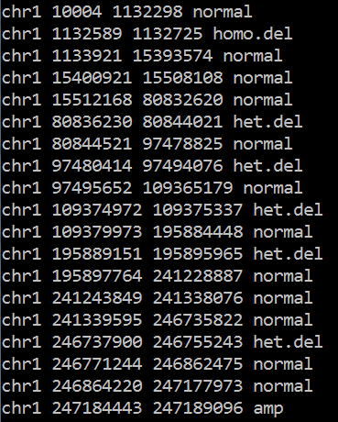
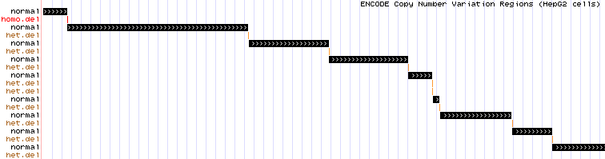
Copy Number Variation Data
CNV Bed file

Slide 5
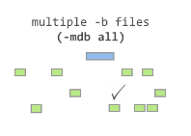

Bedtools – closest
CNV
CNV
Early replication
Early replication
Late replication
Copy number variation:
wgEncodeHudsonalphaCnvRegionsHepG2V2.bed.gz
Early replicating regions:
wgEncodeUwRepliSeqHepg2PkRep1.bed.gz
Late replicating regions:
wgEncodeUwRepliSeqHepg2ValleysRep1.bed.gz

Slide 6
Another Tool Called Bedops
CNV
Early replication
Closest-feature --dist sortedcnv.bed sortedrepstarts.bed > early.bed

Slide 7
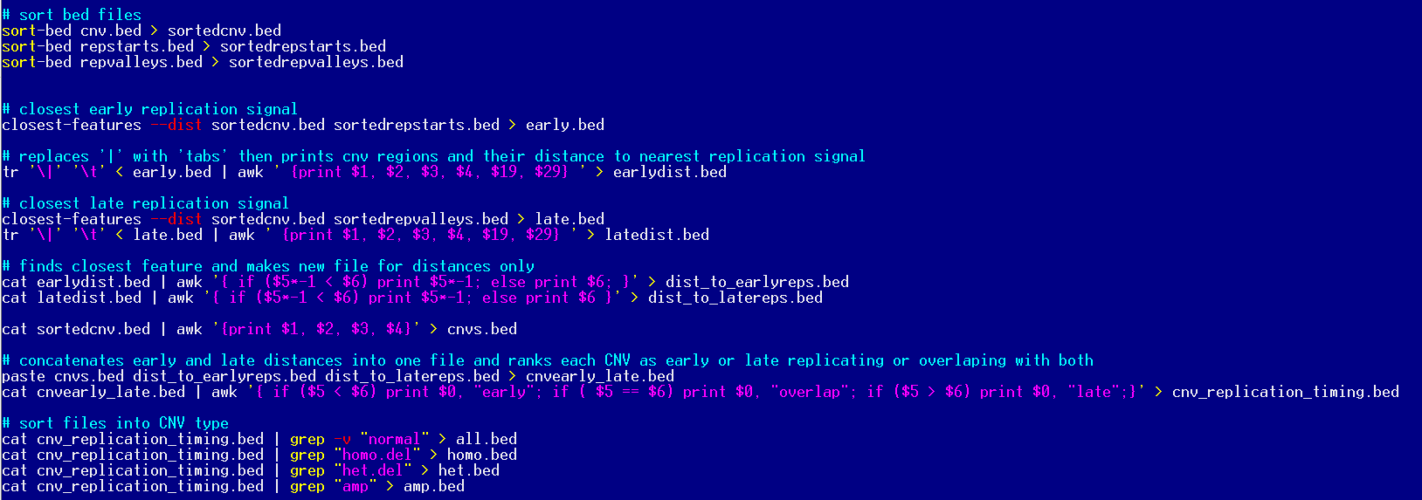
My Awkful Code

Slide 8
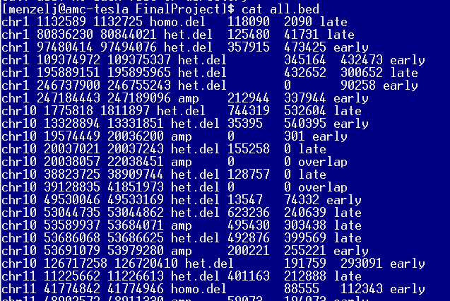
Awkful Output

Slide 9
Findings
91 total CNVs replicate early
91 total CNVs replicate late
77 total CNVs overlap with both early and late replication regions
16 homozygous deletion CNVs replicated early
8 homozygous deletion CNVs replicated late
0 homozygous deletion CNVs overlap with both early and late replication regions
52 heterozygous deletion CNVs replicated early
59 heterozygous deletion CNVs replicated late
40 heterozygous deletion CNVs overlap with both early and late replication regions
23 amplification CNVs replicated early
24 amplification CNVs replicated late
37 amplification CNVs overlap with both early and late replication regions

Slide 10
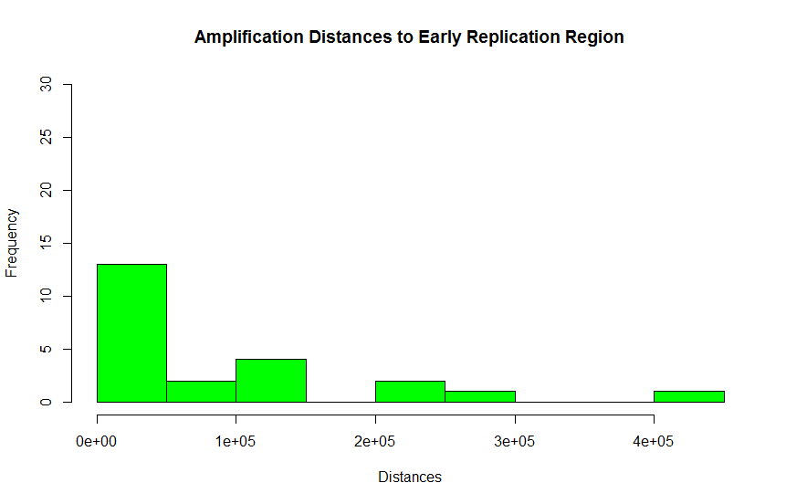
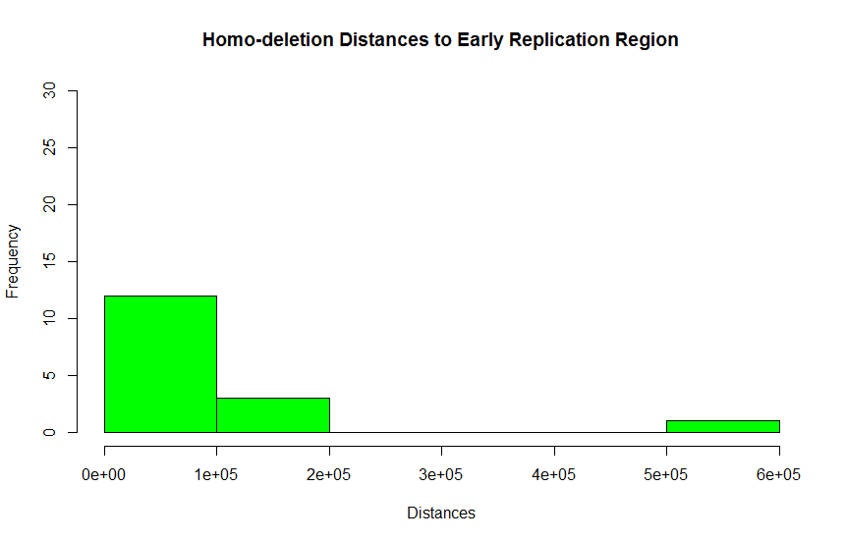
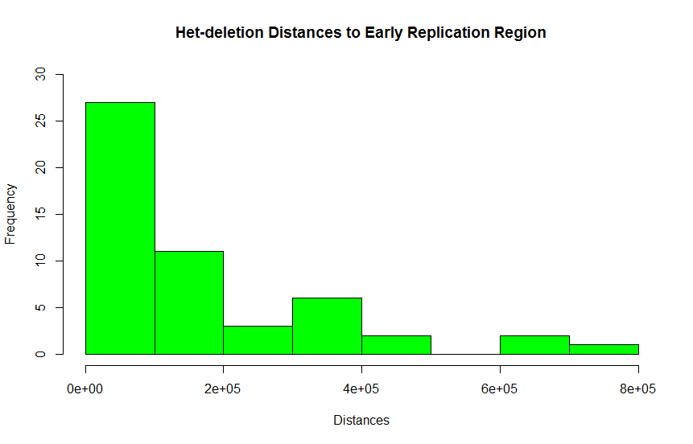
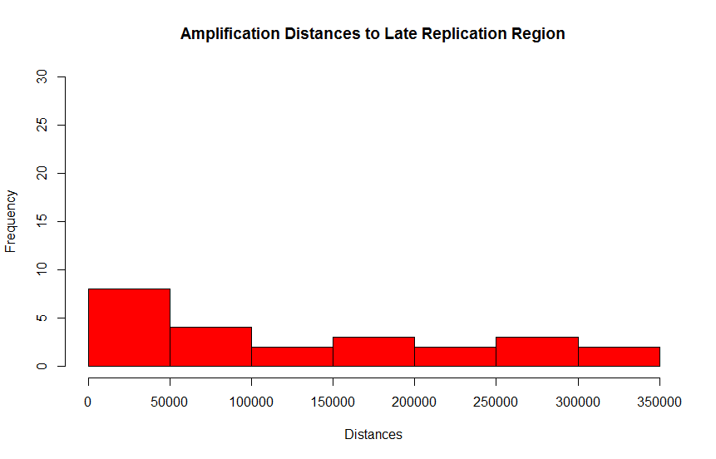
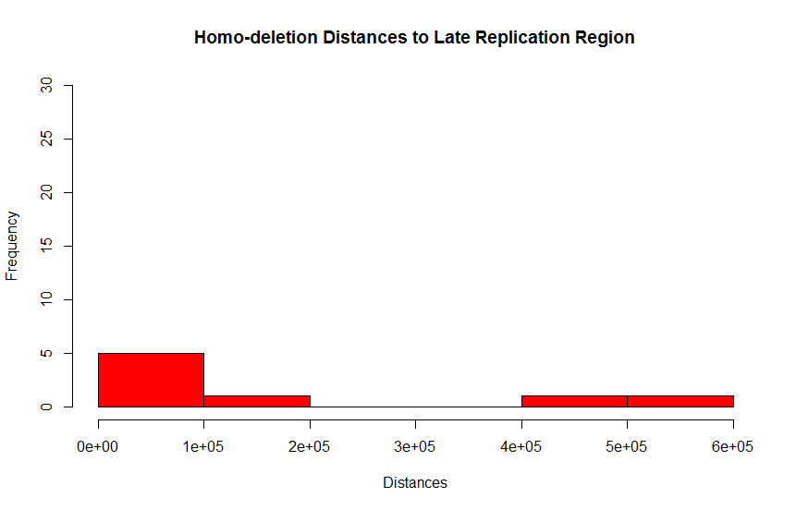

Histograms of Distances

